Slide 1
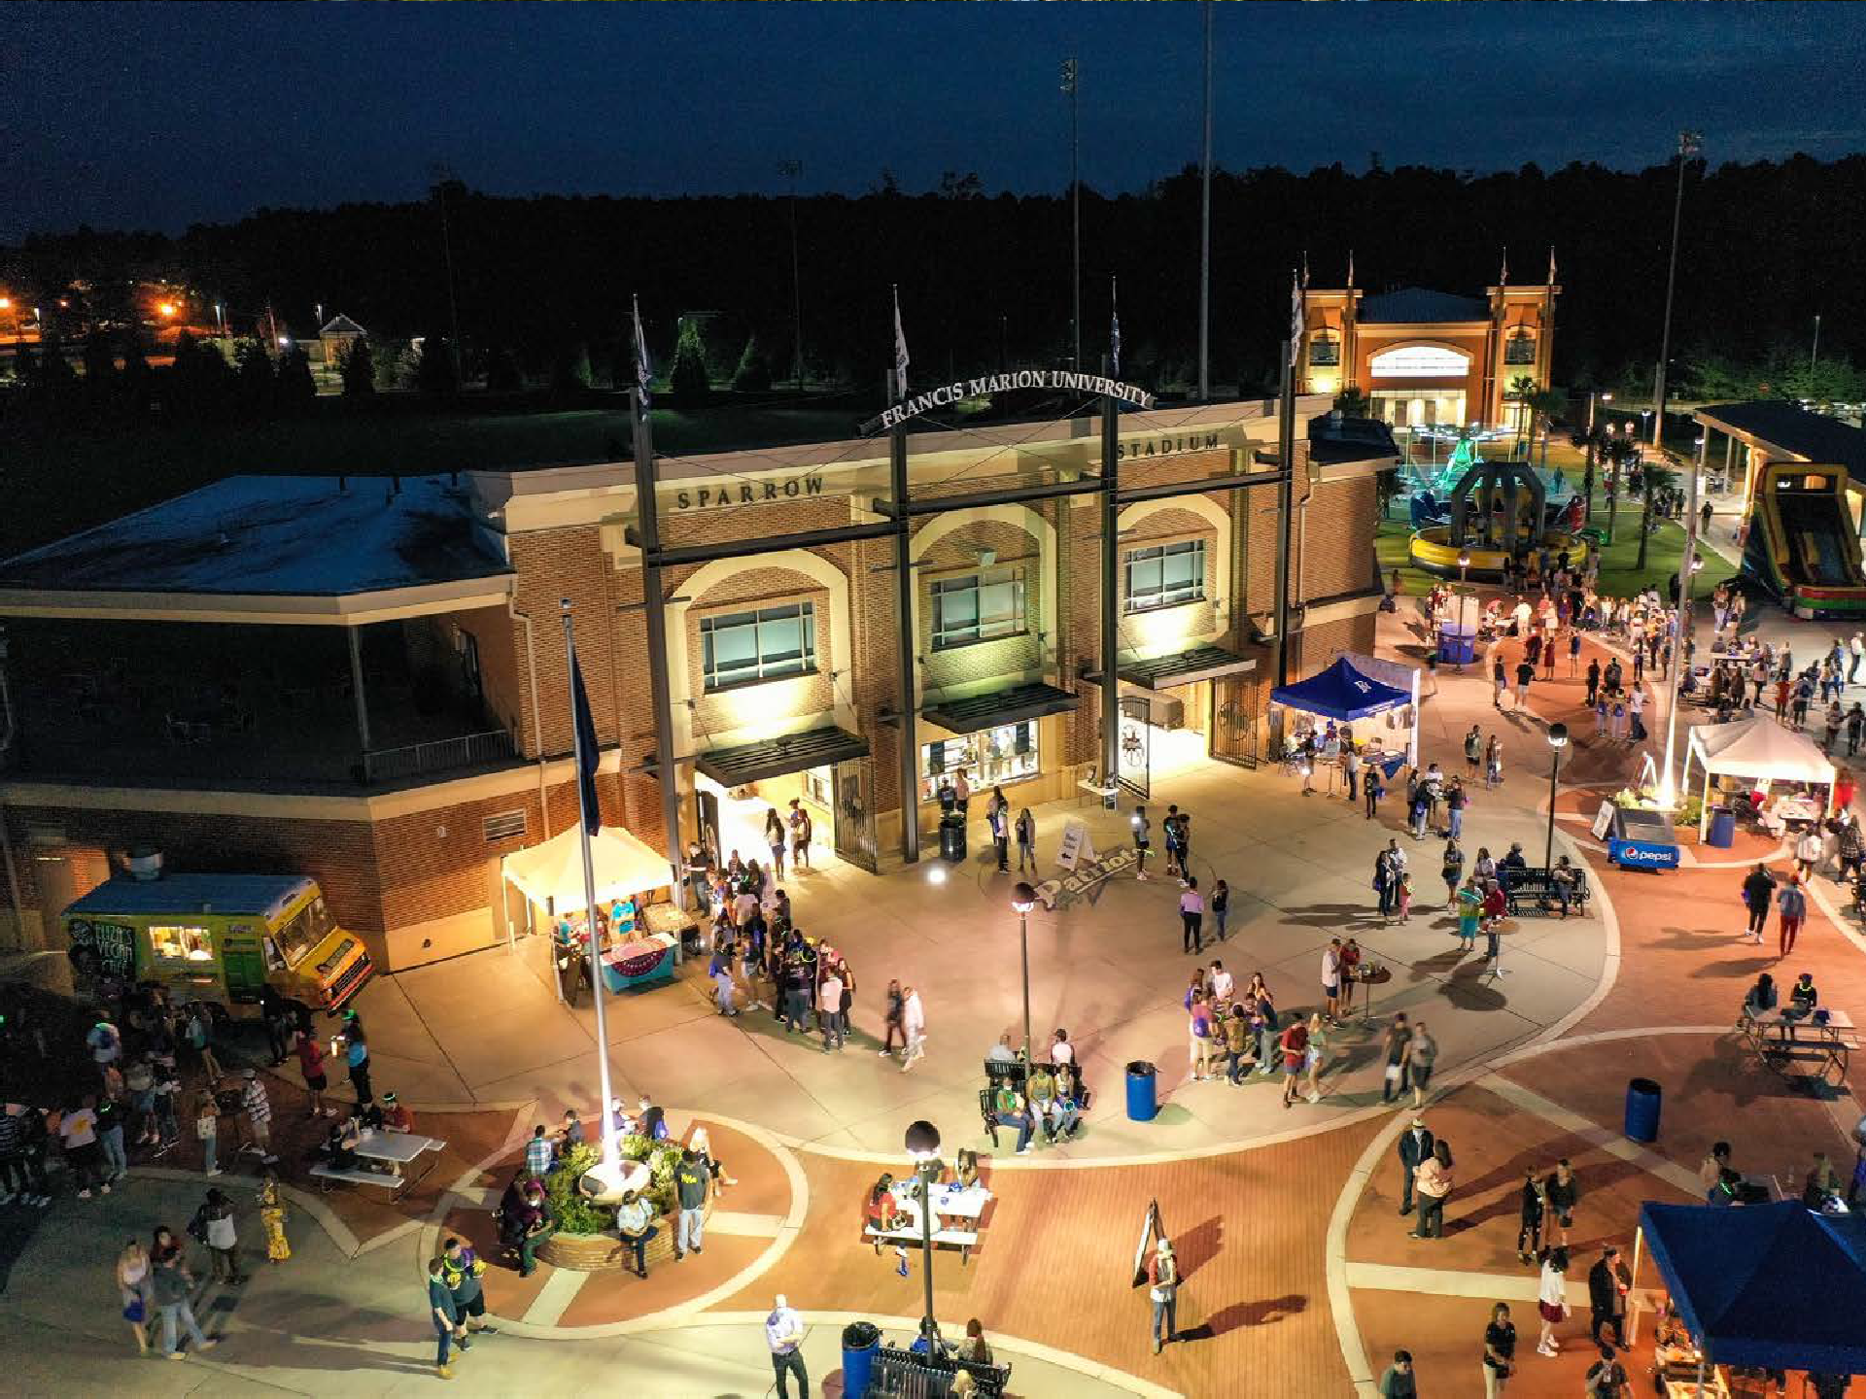

FRANCIS MARION UNIVERSITY
House Ways & Means
Higher Education & Technical College Subcommittee
Budget Hearing for FY2022-23

Slide 2
COVID-19 Expenditures
COVID-19 Fund Sources
Total = $22,855,078
Obligated for Lost Revenue and Covid Response
$5,983,586 26%
SC CARES
Funding
$1,424,512 6%
Institutional HEERF
Funding
$11,475,379 50%
Student
Emergency Aid Distributed
5,086,371
Student Emergency Aid HEERF
Funding
$9,494,792 42%
Student
22%
Supplementary
Institutional HEERF Funding
$460,395 2%

Slide 3
Appropriations History (3 Yrs.)
Total Funds | $83,958,228 | $84,529,125 | $86,216,122
FY21-22 Note: Retirement credit of $308,650 as well as, state recurring allocation increases related to pay plan ($484,535), health / dental ($16,911), and retirement ($136,843) are not included in the chart above but have been received.
3
Notes:
THIS SLIDE ONLY RECONCILES TO THE APPROPRIATION ACT.
State Recurring take into consideration 1A funds.
This slide does not take into consideration Budget Carryforwards (unlike Slide 7), Capital Reserve Funds, Lottery Funds, nor mid year appropriations for COLA’s, Health Ins., Etc. that were received during the 3 years.

Slide 4
Current Revenue
FY21-22
Total Available Operating Resources = $90,691,148
Capital Resources:
2021 Capital Reserve Funds = $10,000,000
FY2021-22 Proviso 118.18 Capital Project Funds = 42,958,113
4
Notes:
Other Revenue and Gifts include the Donations made by both Foundations during the year. This includes scholarship revenue that also comes from the Education Foundation.
State Allocations, Credits and COE Approps include the $350k for the COE that we annually receive, the retirement credit that we receive annually, and the appropriation allocations we received for Dental, retirement, and the pay increase received this year.
State and Local grants are only those operational grants we receive for research and student development. This does not include state scholarships.
Federal Grants do not include scholarship programs as well.
Student Tuition and Fees includes actual cash from students, student scholarship programs (State, Federal, and Other Scholarships except for Ed Foundation and donor related scholarships listed in other revenue and gifts.
Sales of Educ and Aux Services include, Auxiliary Revenues, Center for the Child, PAC, The DHHS contract (not reportable as a grant due to federal regs),

Slide 5
Current Expenditure Budget
FY21-22
Operating Expenditures = $84,007,292
Carryforward and Enrollment Reserve = $6,143,014
Total Operating Budget = $90,150,306
New Capital Projects Budgeted:
$23,000,000 School of Education and Business Building
$21,000,000 Medical Education Facility
$8,958,113 Campus Wide Maintenance Projects
5
Notes:
Slide lumps Instruction, Academic Support, and Scholarships into one category.

Slide 6
Recurring Budget Requests
Request | Amount | Summary
Priority #1 Tuition Mitigation Support | $2,091,000 | FMU has sustained tuition and required fees at the same level for the past three years. As indicated by the Higher Education Price Index trend, expenses are anticipated to increase in FY2022-23 by 2.7%. To avoid a tuition increase, the University requests $2.091m to maintain programs and operations while continuing to offer educational opportunities for South Carolina students.
Priority #3 Environmental Sciences and Forestry Program Support | $950,000 4 - FTEs | FMU seeks to expand current environmental and natural science curricular offerings with the inclusion of a Forestry Management program. Land management, forestry conservation/restoration, policy development, forest ecology and sustainability are all substantial issues for industries and private property owners across South Carolina and the Pee Dee region. With no other instructional programs of this nature in the region, FMU aspires to meet the workforce demands of this significant industry, especially in the Pee Dee and Lowcountry regions of the state.

Slide 7
Non-Recurring Budget Requests
Request | Amount | Summary
Priority #4 Security Connectivity and Monitoring to Main Campus | $500,000 | FMU has seven off-campus buildings located across Florence County. Upgrades to the security systems originally placed in these facilities will enhance both monitoring from the on- campus police facilities and better coordinate with our law enforcement entities with jurisdiction in these remote locations.

Slide 8
Capital Budget Requests
Request | Amount | Summary
Priority #2 - Environmental Sciences and Forestry Building | $18,000,000 | Historically, FMU has offered a broad array of natural science programs with a focus on the biological and environmental sciences, predominately in response to workforce demands. The facility would be located on land contributed by the FMU Education Foundation directly across from the main campus and adjacent to the Department of Natural Resources Pee Dee Regional Office. It will accommodate programs in environmental sciences and forestry, not offered by any other higher education institution in our region of the state. Its proximity to DNR will allow us to expand many of the cooperative programs currently existing between the two entities.

Slide 9
FTE Request
Request | FTEs Needed | Revenue Source | Description
Priority #3 Environmental Sciences and Forestry Program Support | 4 FTEs | Recurring Appropriation Request | FTEs will be for 1 faculty program director and 3 instructional faculty.
Proviso 11.14 Compliance: FMU has made no request that meet the requirements of this proviso.
9

Slide 10
Provisos
Proviso # | Disposition | Purpose & Justification
1A.32 | Keep | Allocation of $350k to the Center of Excellence to prepare teachers of children of poverty. This programmatic support is especially critical to the Pee Dee region since K-12 teachers in the area are significantly more likely to teach children from impoverished areas.
10
10

Slide 11
    Appendix
11

Slide 12
Student Enrollment
12

Slide 13
Student Enrollment cont’d
Newly Enrolled Freshmen Applied, Accepted, & Enrolled
Fall 2020
Fall 2021
Offered Accepted Enrolled
13

Slide 14
Student Enrollment cont’d
In-State & Out-of-State
Headcount
In-State & Out-of-State
FTE
14
Notes:
THIS IS REPORTED BY HEADCOUNT.
FTE WOULD NOT HAVE YEILDED SIGNIFICANTLY DIFFERENT RESULTS.
In-state / Out-of-State Enrollment
In-state – 3,590
Out-of-State – 131
International – 65

Slide 15
Student Enrollment cont’d
Total Success Rate
(Graduated or Remained Enrolled)
FMU Total
5.5%
46.2%
49.5%
64.1%
72.2%
15
Source: National Student Clearinghouse

Slide 16
Tuition & Required Fee History
 | FY2017-18 Increase | FY2018-19 Increase | FY2019-20 Increase | FY2020-21 Increase | FY2021-22 Increase
Tuition Increase | 3.00% | 2.00% | 0.00% | 0.00% | 0.00%
Tuition and Required Fee Increase | 3.97% | 2.93% | 0.00% | 0.00% | 0.00%
16
Notes:
Required Fees increased at a higher % due to the relative size of the fee and due to the increasing need to cover direct IT and Maintenance of the University Facilities that are covered in part due to required fees for IT and Facility.

Slide 17
Tuition Calculation
Fall 2021 Tuition and Required Fees (Per Semester)
 | In-State Undergrad | Out-of-State Undergrad | In-State Grad | Out-of-State Grad | Upper Division (Nursing & Engineering) In-State Undergrad | Upper Division (Nursing & Engineering) Out-of-State Undergrad | Nursing In-State Grad | Nursing Out-of-State Grad | Speech Pathology Program In-State | Speech Pathology Program Out-of-State
Education & General | $5,092 | $10,284 | $5,206 | $10,512 | $8,018 | $16,136 | $8,132 | $16,364 | $9,664 | $19,428
Plant Improvement | $100 | $100 | $100 | $100 | $100 | $100 | $100 | $100 | $100 | $100
Total Tuition | $5,192 | $10,384 | $5,306 | $10,612 | $8,118 | $16,236 | $8,232 | $16,464 | $9,764 | $19,528
Registration | $20 | $20 | $20 | $20 | $20 | $20 | $20 | $20 | $20 | $20
Student Activity Fee | $156 | $156 | $156 | $156 | $156 | $156 | $156 | $156 | $156 | $156
Information Tech. Fee | $112 | $112 | $112 | $112 | $112 | $112 | $112 | $112 | $112 | $112
Facility Fee | $100 | $100 | $100 | $100 | $100 | $100 | $100 | $100 | $100 | $100
Total Tuition and Required Fees | $5,580 | $10,772 | $5,694 | $11,000 | $8,506 | $16,624 | $8,620 | $16,852 | $10,152 | $19,916
17

Slide 18
Scholarships & Grants
FY20-21 Aid | Students | Amount
Federal Pell Grant | 1,770 | $8,716,588
Federal SEOG | 240 | $202,005
HRSA Federal Nursing Grant | 27 | $214,173
Vocational Rehabilitation Grant | 19 | $130,729
Federal Grants and Scholarships | 2,056 | $9,263,495
Life and Hope Scholarship | 1393 | $6,645,564
Palmetto Fellows | 83 | $637,465
National Guard Assistance Grants | 64 | $529,879
SC Need Based Grant | 757 | $1,315,206
Lottery and State Grants and Scholarships | 2,297 | $9,128,114
FMU Scholarships & Outside Scholarships and Grants | 1,007 | $3,442,346
Total Grants and Scholarships | 5,360 | $21,833,955
994
18

Slide 19
Outstanding Debt Report as required by Proviso 11.16
Series 2009A Athletic Facilities Revenue Bonds
Initial Debt: | $8,500,000
Total Interest: | $5,114,391
Year Incurred: | 2010
Pay Off Date: | 12/1/2029
Purpose: | Construction of Athletic Complex
Interest Rate: | 4.98%
Average Annual Principal Expense: | $425,000
Average Annual Interest Expense: | $255,720
Average Annual Debt Service Expense: | $680,720
19

Slide 20
Employee FTEs
FTEs
 | Authorized | Vacant
State | 300.18 | 18.75
Federal | 0.75 | 0.75
Other | 186.43 | 11.90
Total | 487.36 | 31.40*
* 27 FTEs Designated for Open Positions
Headcount - The University has 620 employees with an estimated payroll totaling $33,245,846
Full Time Faculty = 232 Part Time Faculty = 87
Full Time Staff = 267 Part Time Staff = 34
20

Slide 21
Employee Demographics
21
Notes:
Administration includes Department Directors, Academic Chairs, Deans and Associate Deans, and All Senior Staff.

Slide 22
4% Tuition Waiver
& Abatements
 |  | FY18-19 |  |  | FY19-20 |  |  | FY20-21
Program | Level | Students | R | NR | Students | R | NR | Students | R | NR
4% Waivers | Freshman | 3 | 3 | 0 | 2 | 2 | 0 | 67 | 64 | 3
 | Sophomore | 5 | 4 | 1 | 4 | 4 | 0 | 28 | 26 | 2
 | Junior | 7 | 7 | 0 | 2 | 2 | 0 | 22 | 20 | 2
 | Senior | 1 | 1 | 0 | 5 | 5 | 0 | 15 | 14 | 1
 | Other | 1 | 1 | 0 | 1 | 1 | 0 | 11 | 10 | 1
 | Total | 17 | 16 | 1 | 14 | 14 | 0 | 143 | 134 | 9
Full Abatements | Freshman | 39 |  | 39 | 27 |  | 27 | 25 |  | 25
 | Sophomore | 66 |  | 66 | 41 |  | 41 | 27 |  | 27
 | Junior | 24 |  | 24 | 56 |  | 56 | 47 |  | 47
 | Senior | 9 |  | 9 | 20 |  | 20 | 32 |  | 32
 | Other | 17 |  | 17 | 13 |  | 13 | 11 |  | 11
 | Total | 155 |  | 155 | 157 |  | 157 | 142 |  | 142
4% Waiver Methodology: All waivers are provided based on academic merit or financial need. Waivers are used as a supplement to the FMU scholarship programs.
22
Note: FMU has not offered partial abatements in the three-year period covered.
Notes:
Internationals and Out-of-Staters = 196
We abated the out-of-state differential for = 147
Only 25% of our Out-of-Staters pay a portion or all of the out-of-state differential

Slide 23
Capital Projects
Project Number / Name | Project Status | Account Balance Remaining | Project Revenue Sources
Project 9579 – Freshwater Ecology Center | Complete. Project Closeout in Progress. | $716,808 of $5m | $5m - 2019 Capital Reserve Act
Project 9538 – School of Education / School of Business Building | Active – A-1 to increase Budget in progress. | $23,000,000 | $17m – FY21-22 Proviso 118.18 (B)(14) $6m – 2021 Capital Reserve Bill
Project 9582 –Smith University Center | Active - Phase II approval and Athletic Revenue Bond Issuance Approval is in progress. | $60,000 | $60,000 FMU Maintenance Reserve Phase II – Seeks approval for $4m in Athletic Bond Revenue Issuance.
Project 9574 – Honors Learning Center | Complete. Project Closeout in Progress. | $8,478 of $4.3m | $200k – 2016-17 Appropriation Act. $500k – 2016 Capital Reserve Act $2.1m – 2018-19 Appropriation Act $1,144,067 - FMU Maintenance Reserve $355,932 - transfer from Project 9538
Project 9577 - Medical and Health Education Classroom Complex | Complete. Project Closeout in Progress. | $117,838 of $8m | $5m – 2018-19 Appropriation Act $3m – 2018 Capital Reserve Act
Project TBD - Medical Education Facility | Phase I A-1 preparation in progress. | $60,000 of $21,000,000 | $21m – FY21-22 Proviso 118.18 (B)(14)
23

Slide 24
Deferred Maintenance
The University Campus Master was adopted June 2017 and serves as a consolidated capital and maintenance plan. This plan was amended by the FMU Board of Trustees in August 2021 with several listed capital project authorizations.
In FY20-21, FMU spent $2,250,079 on general maintenance needs. The university currently has the following deferred maintenance projects that will be completed over the next two fiscal years:
State Projects | Source of Funds | Status | % Completion
Project 9583 – Campus Wide Renovations | $1,545,000 – FY21-22 Proviso 118.18 | A-1 Phase II – Approved | 0%
Project 9584 – Roads, Parking Lots, and Sidewalks | $3,178,113 – FY21 Capital Reserve Act | A-1 Phase II – Approved | 0%
Project 9585 – McNair & Leatherman Buildings – Reno | $1,150,000 – FY21-22 Proviso 118.18 | A-1 Phase II – Approved | 0%
Project 9586 – McNair & Leatherman Buildings – Roof | $6,000 – FY21-22 Proviso 118.18 | A-1 Phase I – Approved | 0%
Project 9587 – Founders Hall – Renovation | $1,350,000 – FY21-22 Proviso 118.18 | A-1 Phase II – Approved | 0%
Project 9588 – HVAC Systems | $821,887 – FY21 Capital Reserve Act $363,113 – FY21-22 Proviso 118.18 | A-1 Phase II – Approved | 0%
Project 9589 – Founders Hall Roof | $2,250 – FY21-22 Proviso 118.18 | A-1 Phase I – Approved | 0%
24

Slide 25

Awards & Accolades
26
25

